Slide 1





Depression Indicator
Presentation by Copium
Group Member:
Leong Jing Wei
U2005251
Aaron Chee Thian Shin
U2102810
Tan Wei Lin
U2102757
Marvin Chin Yi Kai
U2000490
Sizhao Zou
S2104420

Slide 2


Problem Statement
Suicide is a major public health problem for the world. WHO estimates that there were over 700,000 deaths from suicide in the world in 2019. It is projected to increase in the following year. This increase in suicide rate has been linked with the increase of depression rates.
People who suffer from depression do not always experience the same symptoms, making it hard for an individual to self-diagnose and seek help.
In addition to that, different depression level requires a different kind of approach to be tackled.

Slide 3






Solution
Problem faced
Accurate Indicator
Depression can be an unseen enemies since many users are unsure whether they suffer from depression
Support-vector specifier were trained to give accurate prediction of potential depression faced by users
Answering Questionnaire
Advice
User is required to answer a few questions so that our model can collect data about him/her
Model will come out with a solution recommendation to user based on the severity of depression

Slide 4

Objectives of Project
Build a model to classify the different levels of depression and give advices
Learn common practices for support-vector machine.
Develop insights and hypotheses about the nature of learning problems.

Slide 5
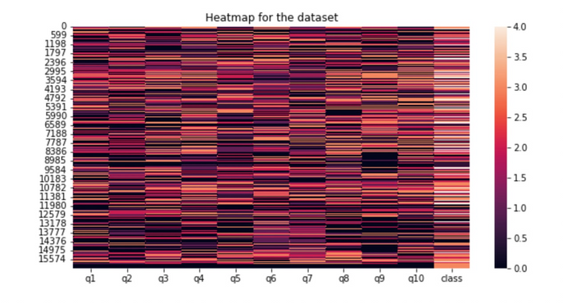
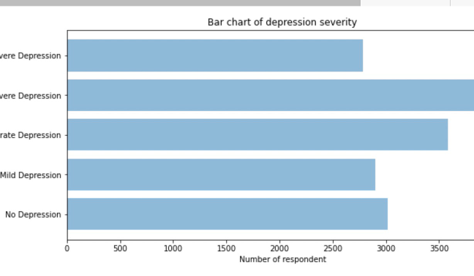
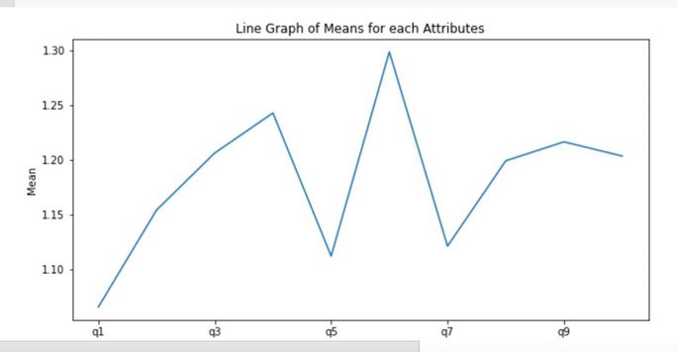
Technical Implementation (Methodology)
There are three main stages in our process: data preprocessing, modelling, and performance analysis.
Data Preprocessing- We load the data and clean it. Then, we start to explore and visualised data with heat-map, bar chart of depression severity, and a line graph of means for attribute.

Slide 6
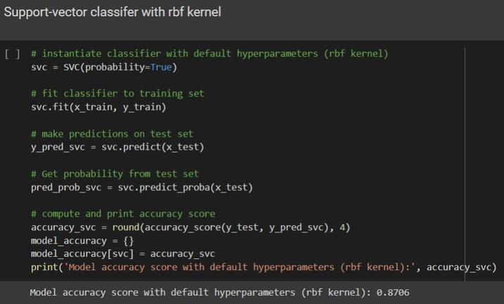
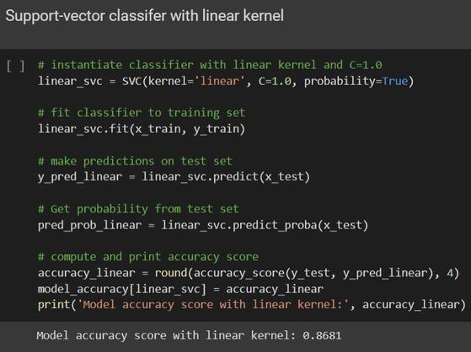
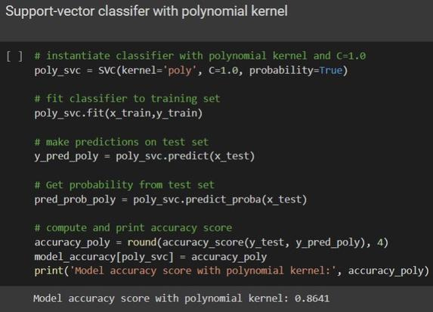
Technical Implementation (Methodology)
Modelling (Support-Vector machines, SVMs): We used a support vector classifier with several different kernels: RBF kernel, linear kernel, and polynomial kernel. Then, we choose the highest accuracy score of the models and save the model.

Slide 7

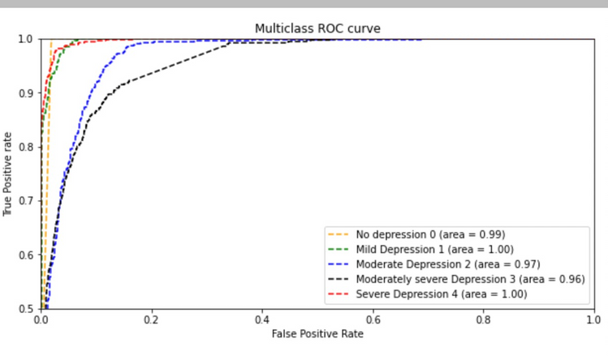
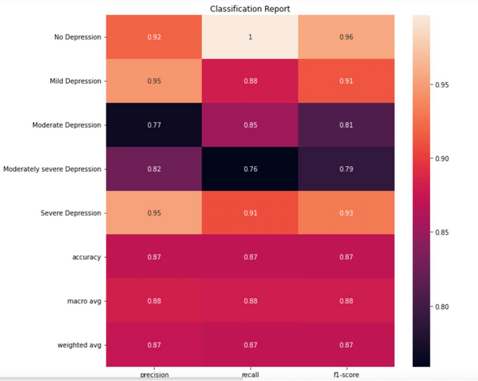
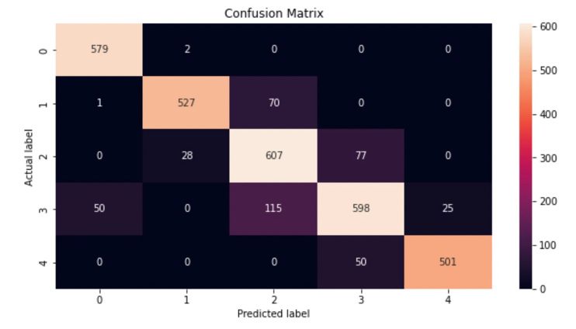
Technical Implementation (Methodology)
Performance Analysis: We compared and selected the model with highest accuracy score. Then, we use area under ROC curve, confusion matrix and classification report to evaluate the performance of our model.

Slide 8





Elaboration on Data & Features Used
Elaboration of Dataset
Recursive Feature Elimination (RFE)
Data collected from survey
Rank Features by importance
A questionnaire to assess participants' psychosocial status
Discard the least important features
Based on the answers given by the participants, it will the evaluate and classify the results into sets of classes.
Refit the model
Repeated until a specified number of feature remain
Benchmark for the model
Classes of depression
Train model more efficiently and effectively by
selecting feature which have more impact
0 for “No Depression.”
1 for “Mild Depression.”
Produces decent results, increase accuracy
and have higher recall (sensitivity) number.
2 for “Moderate Depression”
Obtain a higher score as it removes some
noises from the results.
3 for “moderately severe depression.”
4 for “severe depression”

Slide 9
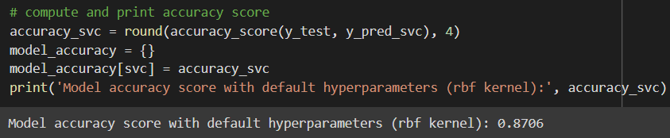
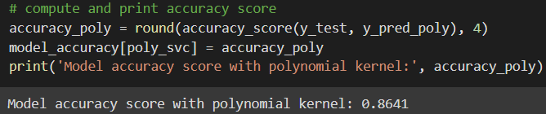
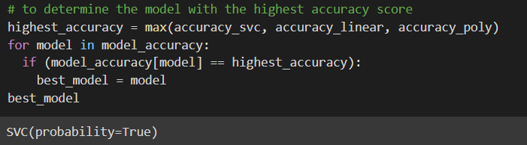
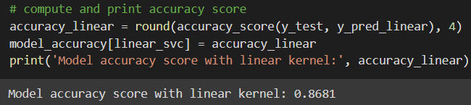

Performance Evaluation Metrics
Accuracy score
Compare the accuracy score for each model and select the highest one to be our model
Model selected: Support Vector Classifier with RBF kernel
Reason: Highest accuracy score (0.8706) among the three classifiers

Slide 10
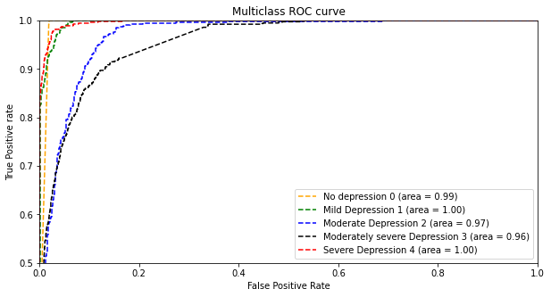
Performance Evaluation Metrics
2. Area under ROC Curve
Calculate the area under ROC curve for each class using One-vs-All technique
Area under ROC curve for all classes are close to 1
Our model is consistent to make predictions and classifications accurately.

Slide 11

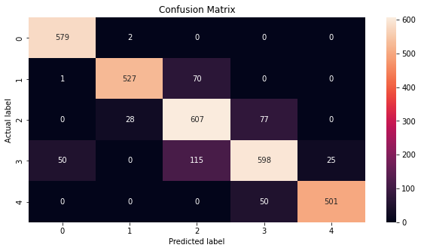
Performance Evaluation Metrics
3. Confusion Matrix
Contains useful information (True Positive, True Negative, False Positive, False Negative)
The diagonal of the table shows the number of outputs where the actual value and the predicted value are the same (True Positive).

Slide 12
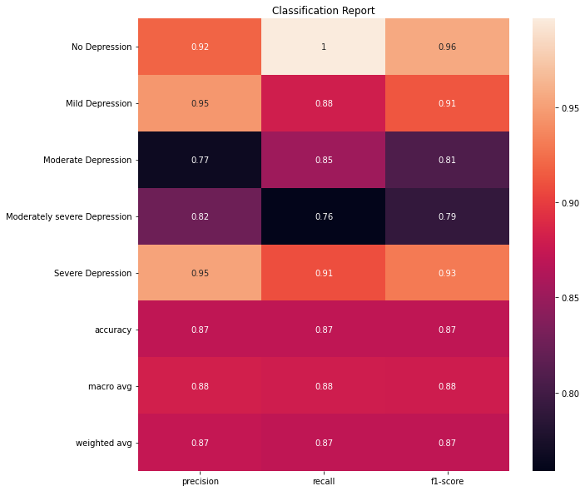

Performance Evaluation Metrics
4. Classification Report
Includes precision, recall, F1 score and support
High precision, recall and F1 score (close to 1)
Overall performance of our model is good

Slide 13
Thank You!

Slide 14
Copium

